Slide 1

Marketing the Ford Ka
Marketing Analytics 95-832, Homework 1
Group 2: Spriha Gupta; Jasmine Kaur; Daniel Lesser; Joseph Standerfer

Slide 2
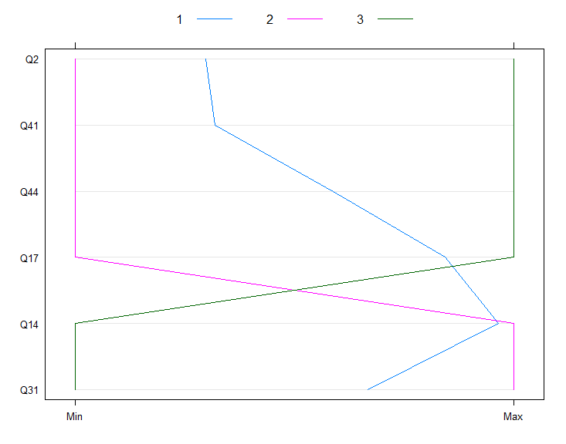
Visualizing our Data
Car preference ranking groups:
Top 3 (Buyers)
Bottom 3 (Non-buyers)
Middle 4 (Fence)
Patterns:
The Buyers are looking for car performance and only somewhat consider the cars fashion and car-size into their buying decision
The Non-buyers (middle 4) are mainly concerned with performance and comfort. They pace little to no value in fashion or making a statement.
Those who fell in the middle placed a much higher value on fashion and would like their vehicle to make statement. Also, they were not looking for comfort or the ability to take road trips.
Q2. I am fashion conscious.
Q14. The car I buy must be able to handle long motorway journeys.
Q17. I want a car that is nippy and zippy.
Q31. I want a comfortable car.
Q41. In today's world it is anti-social to drive big cars.
Q44. I want to buy a car that makes a statement about me.

Slide 3
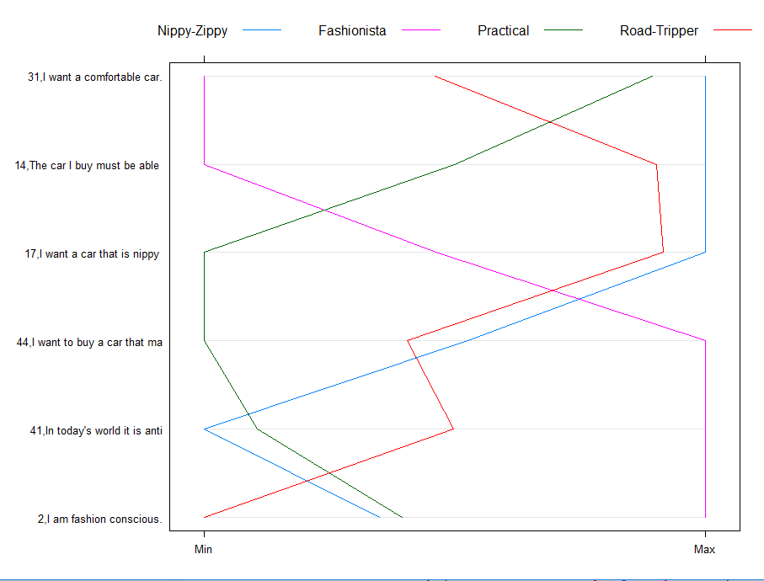
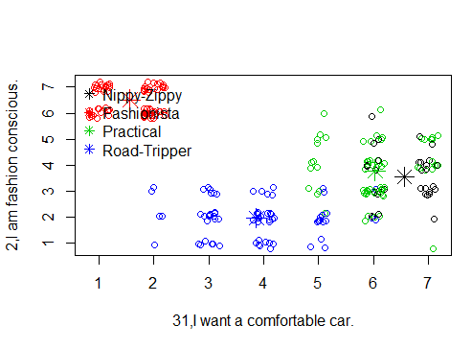
Customer Segmentation
What are your clusters?
What do your clusters mean?
# | Title | Meaning
1 | Nippy-Zippy | Performance driven, looking for a driving experience and the best features
2 | Fashionista | Think of their car as an identity statement, trend conscious, like to stand out, and are mainly city drivers
3 | Practical | Comfort driven, not big on fashion. More utility driven and looking for dependability
4 | Road Tripper | Expect to get a lot of miles out of their vehicle. Place no value in fashion

Slide 4
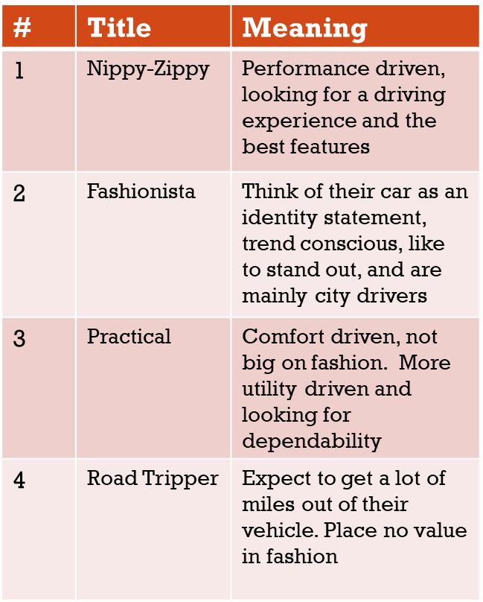
What do the clusters mean?
What are your clusters?
What do your clusters mean?

Slide 5
What do the clusters mean?
What are your clusters?
What do your clusters mean?

Slide 6
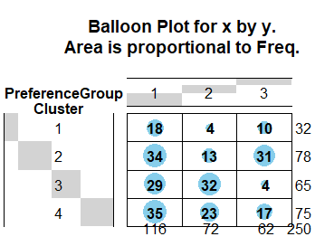
Recommendation of Clustering Solution
We recommend clustering on psychographic dimensions.
Cluster 2 (Fashionistas) is the recommended segment to target as it has the greatest number of choosers and neutrals who can be influenced. This segment also aligns with the target audience that Ford is trying to win over from the Renault Twingo.
Cluster 1 (Nippy-Zippy) appears to be the natural buyers for the Ford Ka, with 56% of individuals rating the car in the top 3 and 31% rating it in the middle.
However, this cluster is relatively small and thus should be a secondary focus for Ford.
In addition, the cluster is fundamentally different than Cluster 2, so creative marketing will be required to reach both segments at the same time.

